Slide 1
TrackPack
Keeping your child safe

Slide 2
Peace of Mind
Write something in this section
First: What is a Fast-Fish? Alive or dead a fish is technically fast, when it is connected with an occupied ship or boat, by any medium at all controllable by the
Mission
Vision
First: What is a Fast-Fish? Alive or dead a fish is technically fast, when it is connected with an occupied ship or boat, by
First: What is a Fast-Fish? Alive or dead a fish is technically fast, when it is connected with an
Goals
Values
First: What is a Fast-Fish? Alive or dead a fish is technically fast, when it is connected with an occupied ship or boat, by
First: What is a Fast-Fish? Alive or dead a fish is technically fast, when it is connected with an
Goals
Values
First: What is a Fast-Fish? Alive or dead a fish is technically fast, when it is connected with an occupied ship or boat, by
First: What is a Fast-Fish? Alive or dead a fish is technically fast, when it is connected with an

Slide 3
Our Services
Write something in this section
First: What is a Fast-Fish? Alive or dead a fish is technically fast, when it is connected with an occupied ship or boat, by any medium at all controllable by the occupant or occupants,—a mast, an oar, a nine-inch cable, a telegraph wire, or a strand of cobweb, it is all the same. Likewise a fish is technically fast when it
Service Name
Service Name
Service Name
A telegraph wire, or a strand of cobweb,
A telegraph wire, or a strand of cobweb,
A telegraph wire, or a strand of cobweb,
Service Name
Service Name
Service Name
A telegraph wire, or a strand of cobweb,
A telegraph wire, or a strand of cobweb,
A telegraph wire, or a strand of cobweb,
Service Name
Service Name
Service Name
A telegraph wire, or a strand of cobweb,
A telegraph wire, or a strand of cobweb,
A telegraph wire, or a strand of cobweb,

Slide 4
Project Title
First: What is a Fast-Fish? Alive or dead a fish is technically fast, when it is connected with an occupied ship or boat, by any medium at all controllable by the occupant or occupants,—a mast, an oar, a nine-inch cable, a telegraph wire, or a strand of cobweb, it is all the same.
Project Title
First: What is a Fast-Fish? Alive or dead a fish is technically fast, when it is connected with an occupied ship or boat, by any medium at all controllable by the occupant or occupants,—a mast, an oar, a nine-inch cable, a telegraph wire, or a strand of cobweb, it is all the same.
Project Title
First: What is a Fast-Fish? Alive or dead a fish is technically fast, when it is connected with an occupied ship or boat, by any medium at all controllable by the occupant or occupants,—a mast, an oar, a nine-inch cable, a telegraph wire, or a strand of cobweb, it is all the same.

Slide 5

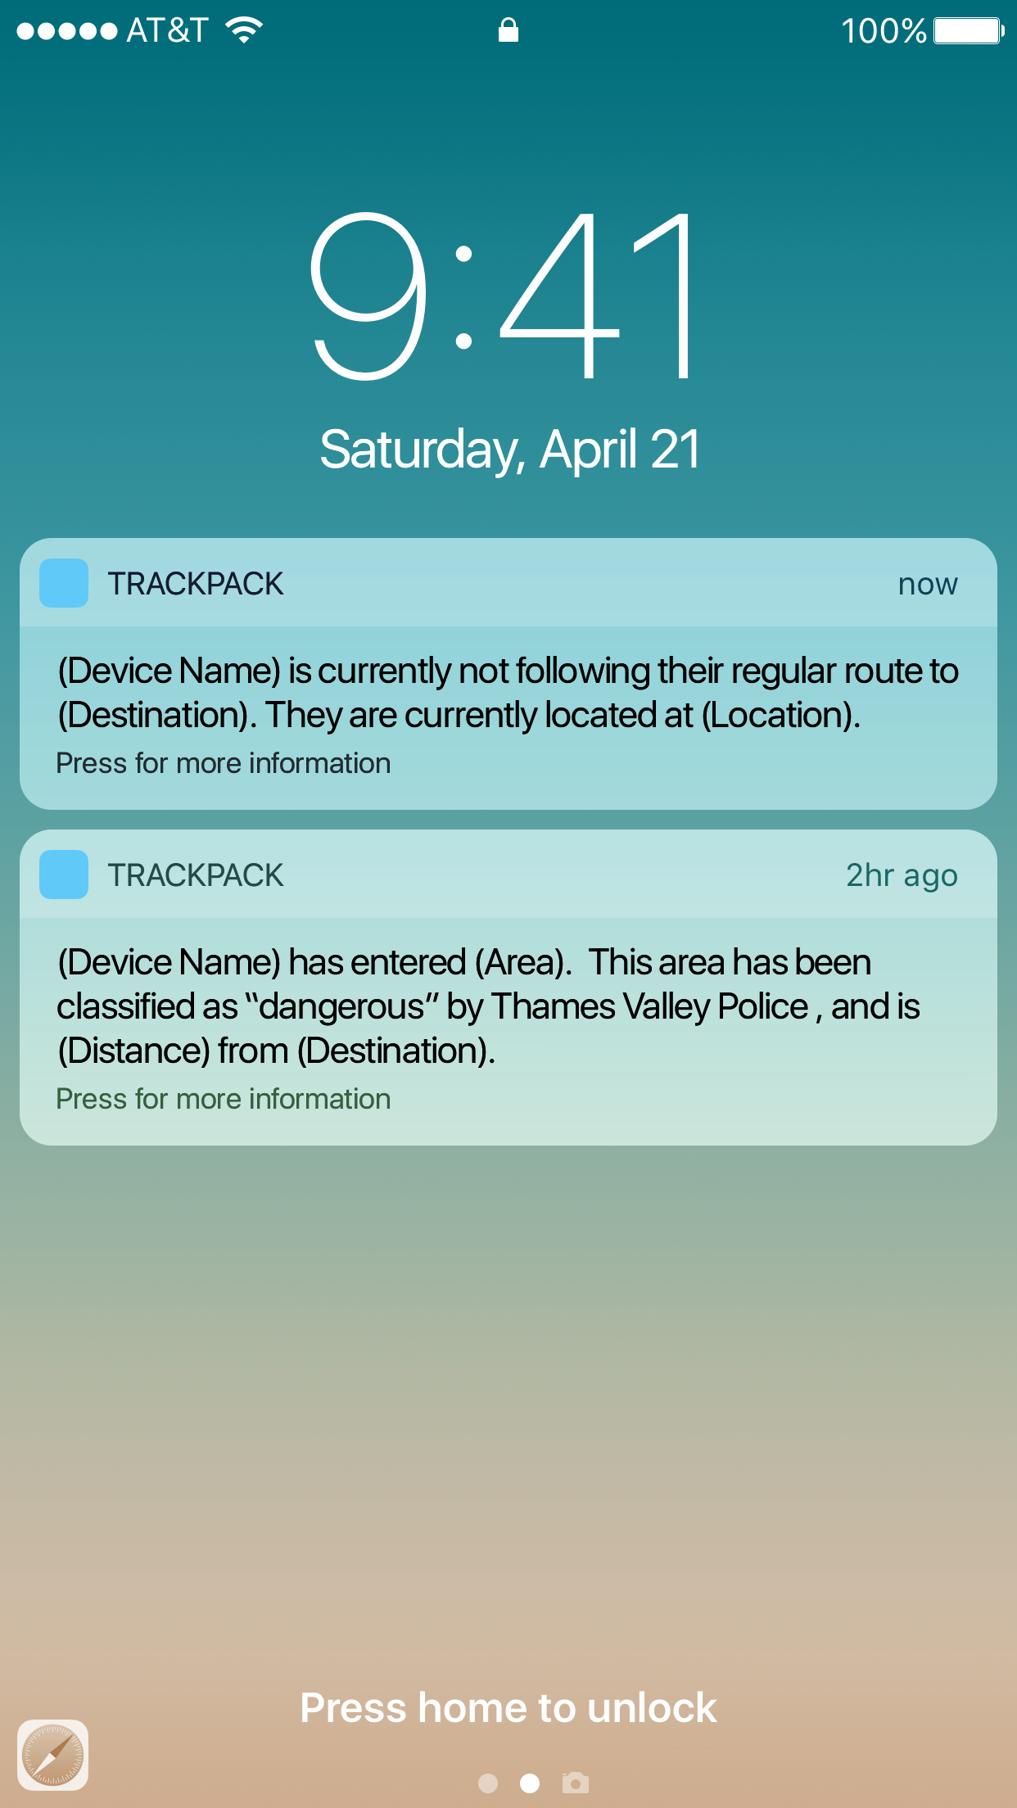

iPhone Mockup Included
Write something in this section
First: What is a Fast-Fish? Alive or dead a fish is technically fast, when it is connected with an occupied ship or boat, by any medium at all controllable by the occupant or occupants,—a mast, an oar, a nine-inch cable, a telegraph wire, or a strand of cobweb, it is all the same. Likewise a fish is technically fast when it bears a waif, or any other recognized symbol of possession; so long as the
First: What is a Fast-Fish? Alive or dead a fish is technically fast, when it is connected with an occupied ship or boat
First: What is a Fast-Fish? Alive or dead a fish is technically fast, when it is connected with an occupied ship or boat
First: What is a Fast-Fish? Alive or dead a fish is technically fast, when it is connected with an occupied ship or boat

Slide 6
WRITE A TITLE IN THIS SECTION
Get in Touch
With Us
A telegraph wire, or a strand of cobweb, it is all the same. Likewise a fish is technically fast when it bears a waif, or any other recognized
Send us a message or visit us
Whenever you like
Empire State Building
350 5th Ave, New York, NY 10118
(212) 736-3100

Slide 7

Download More Templates

